Slide 1
CS 470 Project Two Conference Presentation: Cloud Development
[Student’s Full Name]
[Month/Year]

Slide 2
Overview
Introduce yourself.
State the purpose of the presentation: to articulate the intricacies of cloud development to both technical and nontechnical audiences.
Attention: Modify this template to accommodate your content and to reflect your style of communication. You may write a script as notes below each slide and then save the notes as your transcript. Delete this box before submitting.

Slide 3
Containerization
Explain the models used to migrate a full stack application to the cloud.
What tools are necessary for containerization?

Slide 4
Orchestration
What is the value of using Docker Compose?

Slide 5
The Serverless Cloud
Serverless
What is “serverless” and what are its advantages?
What is S3 storage and how does it compare to local storage?

Slide 6
The Serverless Cloud
API & Lambda
Describe the advantages of using a serverless API.
Explain Lambda API Logic.
What scripts are produced in order to make this happen?
Summarize the steps needed to integrate the frontend with the backend.

Slide 7
The Serverless Cloud
Database
What are the data-model differences between MongoDB and DynamoDB?
What queries did you perform?
What scripts are produced in order to make this happen?

Slide 8
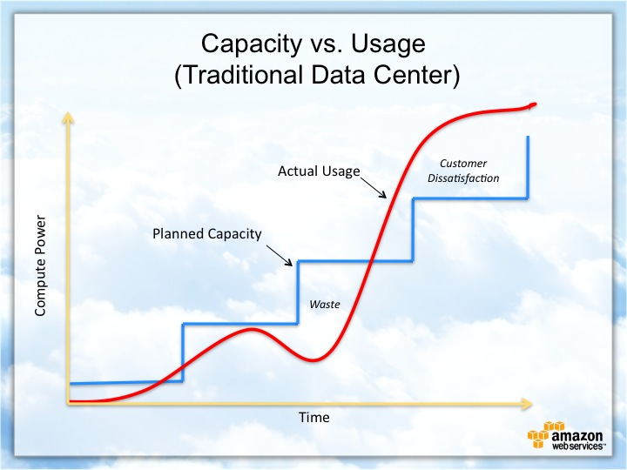
Cloud-Based Development Principles
Elasticity
Pay-for-use model

Slide 9
Securing Your Cloud App
Access
Policies
API Security
How can you prevent unauthorized access?
Explain the relationship between roles and policies.
What custom policies were created?
How can you secure the connection between Lambda and Gateway?
Lambda and the database
S3 Bucket
Optional: Break this into three separate slides.

Slide 10
Conclusion
Briefly recount three main points that are salient to your explanation and demonstrate your understanding of cloud development.
Thank you for your time.

